Slide 1
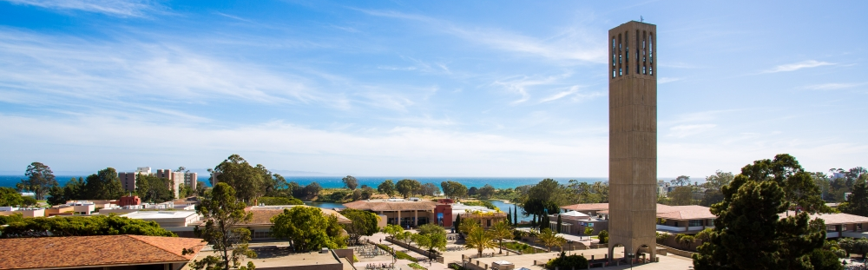
UC SANTA BARBARA
Office of Financial Aid & Scholarships
welcome to
WORK STUDY TRAINING
Maria Galicia
Christina Gutierrez
Notes:
To UCPath Initiators: Our slides work best when they are in the presenter view mode so one can access the notes and animation of each slide.

Slide 2





Introduction
Guidelines
AGENDA
Handshake
Referrals
UCPath
UCPath
CalFresh
Notes:
For our work study agenda, we will be going over the following topics. Please note that each slide is color coded to match their corresponding agenda topic.

Slide 3

WHAT IS WORK-STUDY?
“Develop and promote part-time undergraduate and graduate employment opportunities for students with financial need.”
Dept 40% (+ 10% administrative fee*) - WSP 60% Split
Depts pay 40% of wages for students on Work-Study!
EXAMPLE: $100 gross earnings
$40 dept cover
$10 admin fee from dept
$60 WSP cover
Cut Off Period – Typically Winter quarters
WSP = Work Study Program
Notes:
Work study is a need-based form of financial aid that students can earn through on or off campus employment. The purpose of work study is to help students meet higher education costs, reduce their reliance on loans, and gain work experience.
Work study provides incentives for our on-campus departments as work study pays for 60% of the students gross earnings while the department pays 40% in addition to a 10% admin or surcharge fee that is assessed. In total, departments only pay for 50% of their student employee wages for those on work study. For example, if a work study student earned $100 gross earnings, the department will cover $40 of those earnings plus a $10 admin fee. The work study program will therefore pay $60 of the student’s wages. It’s like hiring two students for the price of one!
It’s important to note that once a student has utilized their entire work study award or their earnings under work study has reached it’s maximum, work study can no longer pay for the student’s earnings and will therefore be paid out of the departments funding.
During the winter, the Office of Financial Aid & Scholarships won’t be accepting work study referrals when we anticipate that our funding source is reaching capacity. In previous years, this typically occurs during January or February but can vary depending on the level of our funding source. We understand that this may be a stressful time for our departments, so we announce this cut off period a couple of weeks in advance so our departments can still hire work study students prior to the cut off.

Slide 4

ADMIN/SURCHARGE REPORTS
Monthly
  Used to detail administrative charges for work-study students
  Used for Reconciliation
Notes:
As mentioned earlier, departments with work study students will be assessed a 10% admin fee. This admin fee will show up in the form of a surcharge report that will be sent monthly to the UCPath initiators in your department. Additionally, you can verify the admin fee when reconciled against wages earned by each student. If there are students who have not had an admin fee assessed or shown in the surcharge report, it is most likely because these funds are not splitting in UCPath. If so, please contact us so we can identify and troubleshoot any problems. Transactions not shown on the surcharge report will be journaled to your department by our office.

Slide 5
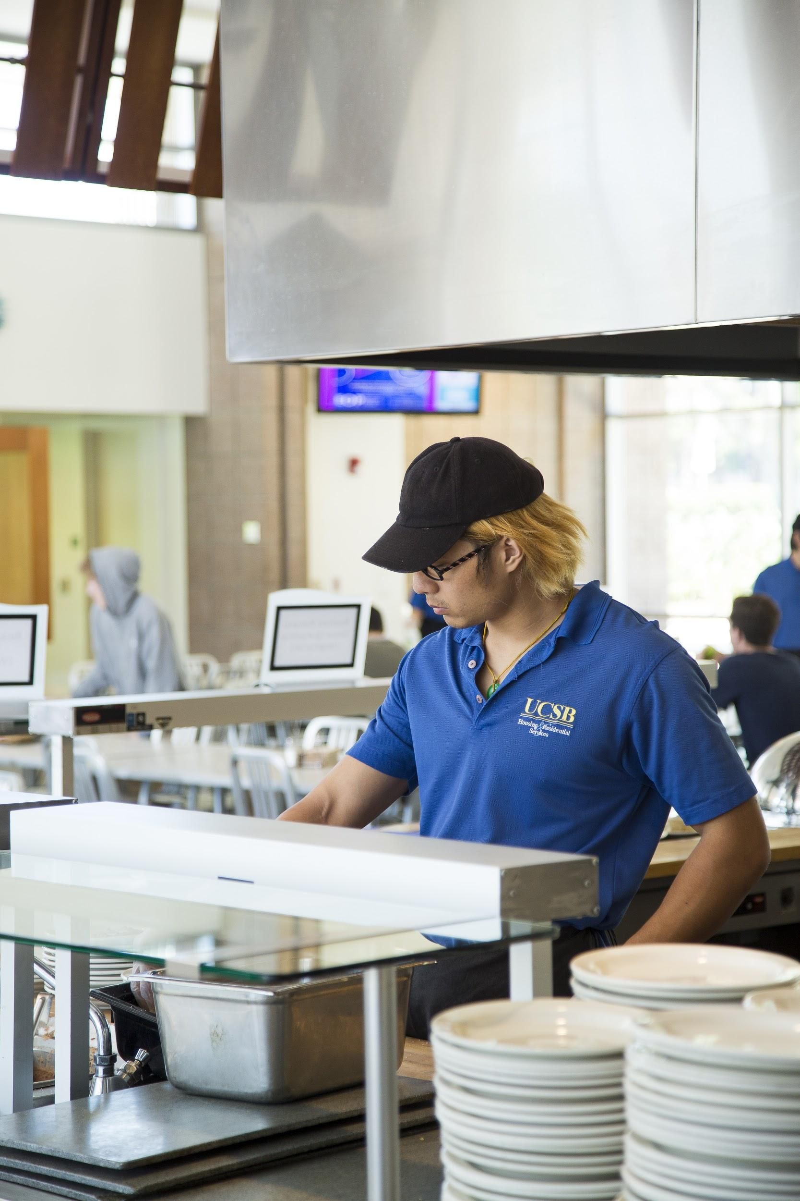
ELIGIBILITY
Students
  Offered in 25-26 Award Letter (Work Study Referrals)
  Referrals available Sept 8, 2025
  Work-Study begins Sept 14, 2025; ends June 6, 2026
  Work-Study Awards typically $3,000
Department Positions
  At Least Minimum Wage
    January 1, 2026 - increase from $16.50/hr to $16.90/hr (expected based on inflation trigger)
  Non-Career Staff Positions
  Job Description Required
    Clearly defined job functions
    Establish clear work expectations
    Must be detailed
Notes:
As mentioned earlier, work study is a need-based form of financial aid. To be applicable for work study, students must file a FAFSA or Dream Act application prior to May 2nd (and have sufficient financial need). Depending on their need, each student may vary in the amount of their work study award or may have their award reduced or increased depending on their financial situation. It is therefore crucial that departments have enough funding to cover their student employee’s earnings with or without work study eligibility.
We understand that during the cutover period for UCPath can be a stressful time for our departments, so work study referrals will be available Sept 8th, although the program does not begin until the 14th. Referrals printed after the 8th will auto-generate to the 14th. After that, referrals will be dated the day it was printed. These dates indicate when work study will begin for the student and when they start earning under work study funds. We hope that this week gap will allow our UCPath initiators time to hire work study students. It’s important to note that a work study referral is not required to start creating positions on UCPath.

Slide 6

WS EMPLOYMENT REGULATIONS
On-Campus Work Study students are governed by:
Federal Employment Regulations
34 CFR Ch. VI, Part 675
Policies for Non-Represented UCSB Employees
HR Policies
Notes:
Moving on to the Work Study Guidelines, our on-campus work study students are governed by the same regulations and policies as our full-time staff are. Once these slides are shared with our UCPath initiators, we encourage you all to go over and review these regulations and policies.

Slide 7

Work-Study Recommendations
15-20 hours per week (guideline)
Work-Study cannot pay for:
  Benefits of any kind
  Non-Federal Share may be subjected to both benefit accruals and state & federal taxes
Retain WSP employment records for 5 years
  WS Job description
  WS Referral (Copy)
  Timesheets
Post to Handshake
Position Pool
Notes:
We recommend that students work no more than 15-20 hours per week. While working can help build skills and provide work experience to students, we want to emphasize that school is the main priority for our students and encourage them in succeeding in their academics and graduating on time. Remember that school is full-time and work-study is part-time.

Slide 8
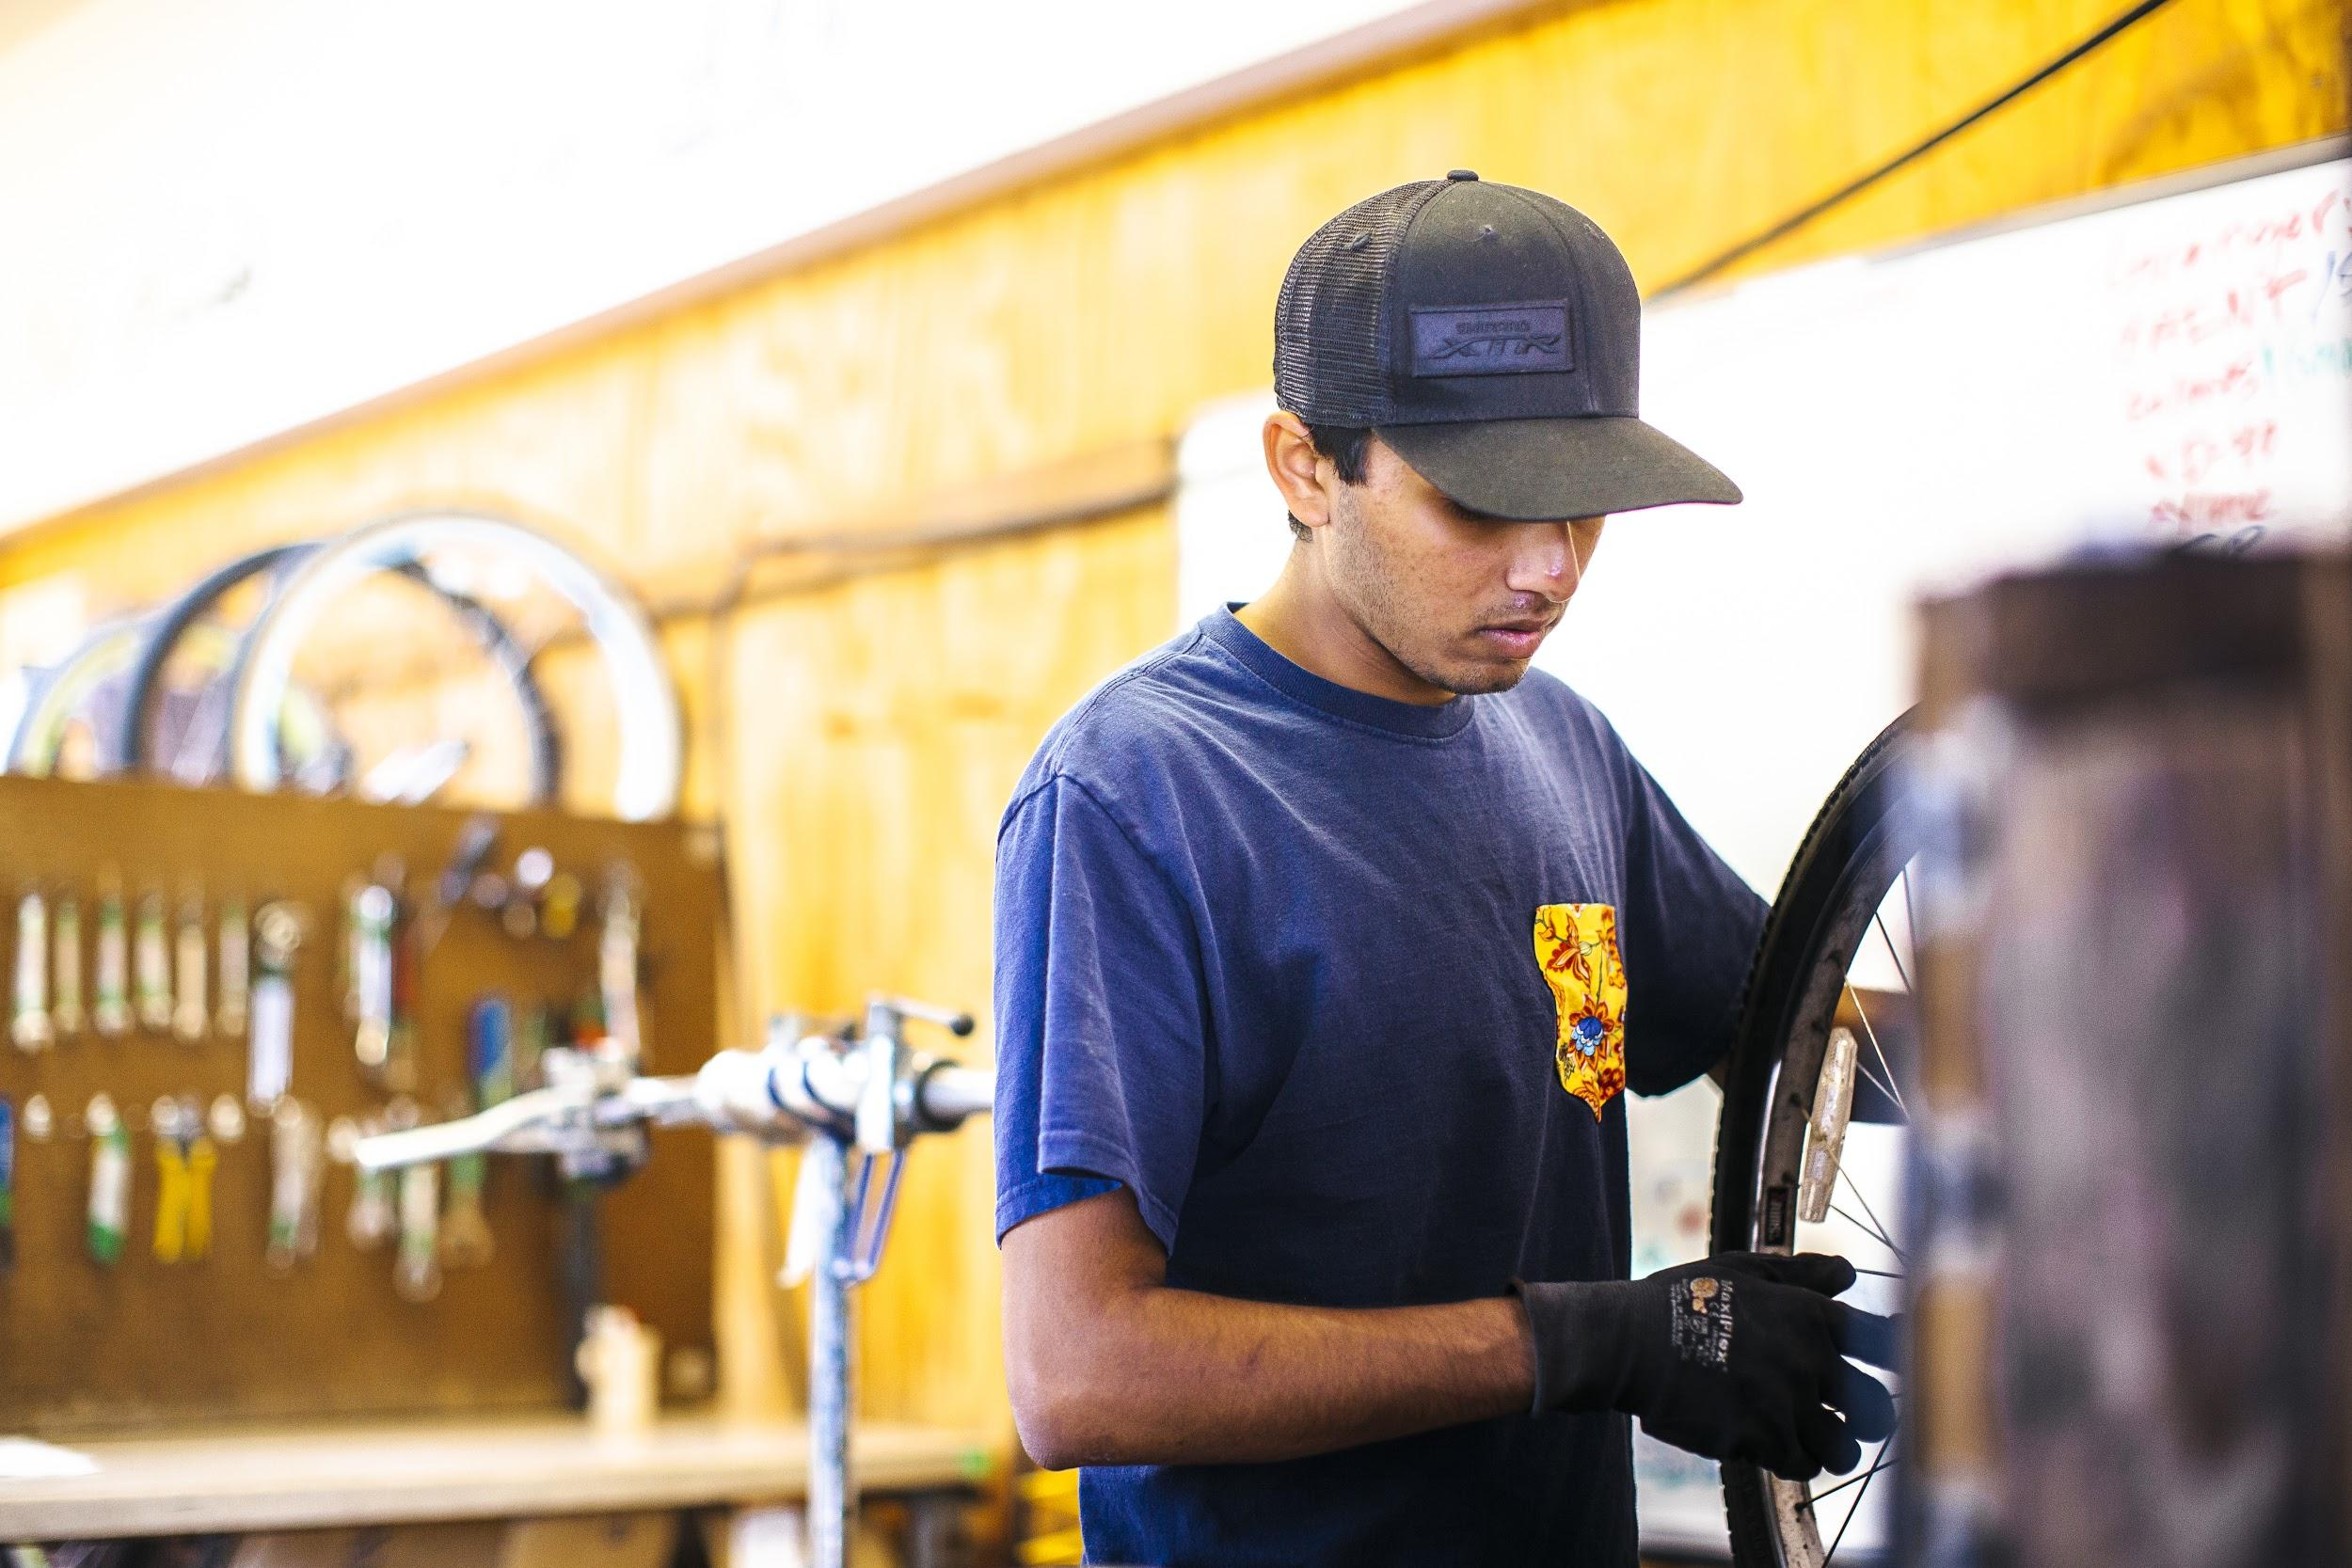

HANDSHAKE
UCSB’s new powerful recruiting platform
What can you do with Handshake?
  Part-time or Full-Time jobs
  Internships
  Work-Study Positions
  Career Services Updates
  Career Fair Registration
Sign Me Up!
  https://career.sa.ucsb.edu/faculty-and-staff
  Employer.Services@sa.ucsb.edu
Notes:
If you don’t know what Handshake is, Handshake is UCSB’s new powerful recruiting platform that allows employers, such as yourselves, to post work-study positions and more. We highly encourage our departments to post their job listings on Handshake and flag them under work study as many students use this platform to find jobs.

Slide 9

CAREER SERVICES - HANDSHAKE
Handshake Trainings:
  Contact: Jo Ann Villanueva-Salvador (joann.salvador@sa.ucsb.edu)
  For questions email: employer.service@sa.ucsb.edu
Important Handshake Dates - Work-Study:
August 15, 2025 - Students are able to apply
Sept 8, 2025 - WS Referrals available for students
Sept 14, 2025 - WS Program Begin Date
May 31, 2026 – WS program End Date (MO)
June 6, 2026 - WS Program End Date (Bi-weekly)
Notes:
If you are new to Handshake or would like to refresh your skills on Handshake, we encourage you to contact Jo Ann Villanueva-Salvador joann.salvador@sa.ucsb.edu. Handshake trainings for departments typically happen during the summer months, for more information please contact career services.
It is important to note that students can be hired before the program start date of Sept 14th, but not as a work study position, the department is responsible to pay 100% of their earnings prior to the beginning of WS

Slide 10

Work Study Referrals
Verifies a student’s work study eligibility
Must be submitted the Wednesday before the pay period end date
Four letter Department Code
Earned Code: REG
Start/End Date
Fund/FRU/Account/Purpose/Program/Project/Activity/Campus Commitment
Employee Classification
5 Student - Support Staff
Academic Student
Position Pool ID
F Undergraduates
D UC Work-Study
(previously named Deferred Action)
E Non-California Undergrad Resident
W Graduate
Notes:
A work study referral verifies a student’s work study eligibility and can be accessed through a student’s financial aid award letter at finaid.ucsb.edu. A work study referral is required for a student to earn off of work study funds. These work study referrals must be submitted to our office the Wednesday before the pay period end date. This will allow sufficient time for our department to process work study referrals especially when we receive high volumes of referrals and to allow work study funds to splits within the correct pay period.
On these work study referrals, the four letter department code is required, the earned code is regular, and the start and end date for the student to earn under work study is required. Typically, the start date is the date when the student prints out their work study referral and the end date is June 6th, 2026. Wages will begin splitting after the start date on the referral. The new CCOA funding information for the department is also required on the work study referrals.
An employee classification code is also required on the work study referrals. Code 11 is used for academic positions while code 5 is used for student-support staff positions.
The Work-Study unit no longer accepts paper submissions, referrals will need to be emailed to finaidwsp@sa.ucsb.edu. Our office will review and inform your departments if anything needs to be corrected.
All academic positions should be requested to AP-Path@ucsb for all academic students

Slide 11
How Students Access
WORK-STUDY Referrals
Screenshots
Notes:
To review how to access work study referrals from the student perspective, here are some screenshots that can help guide the UCPath preparer.

Slide 12
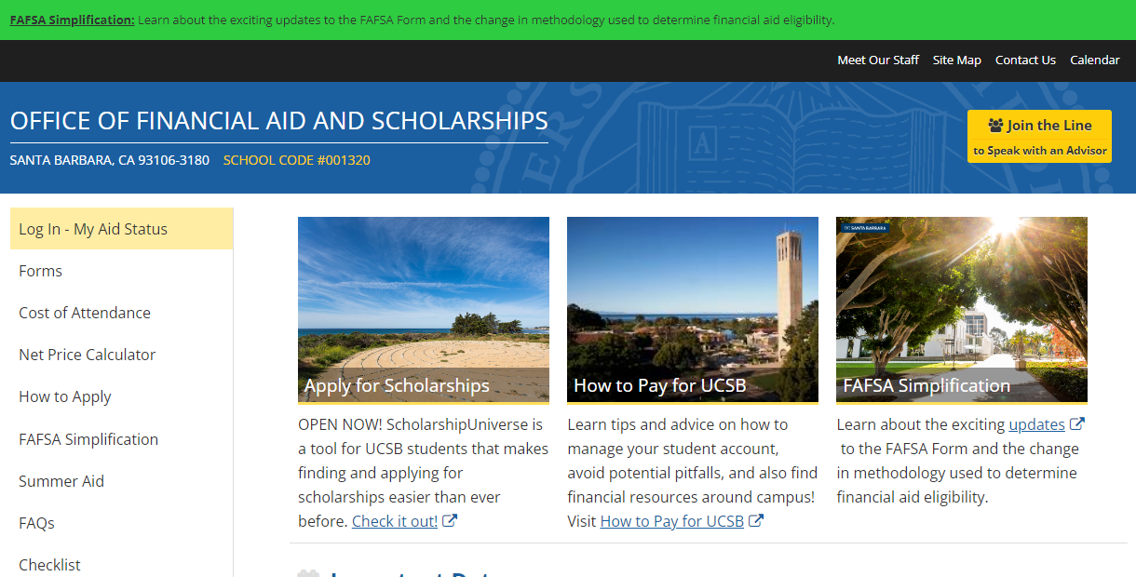
Notes:
After going to finaid.ucsb.edu, students can click on “Log In - My Aid Status” which will redirect them to sign in using their UCSBNetID and password.

Slide 13
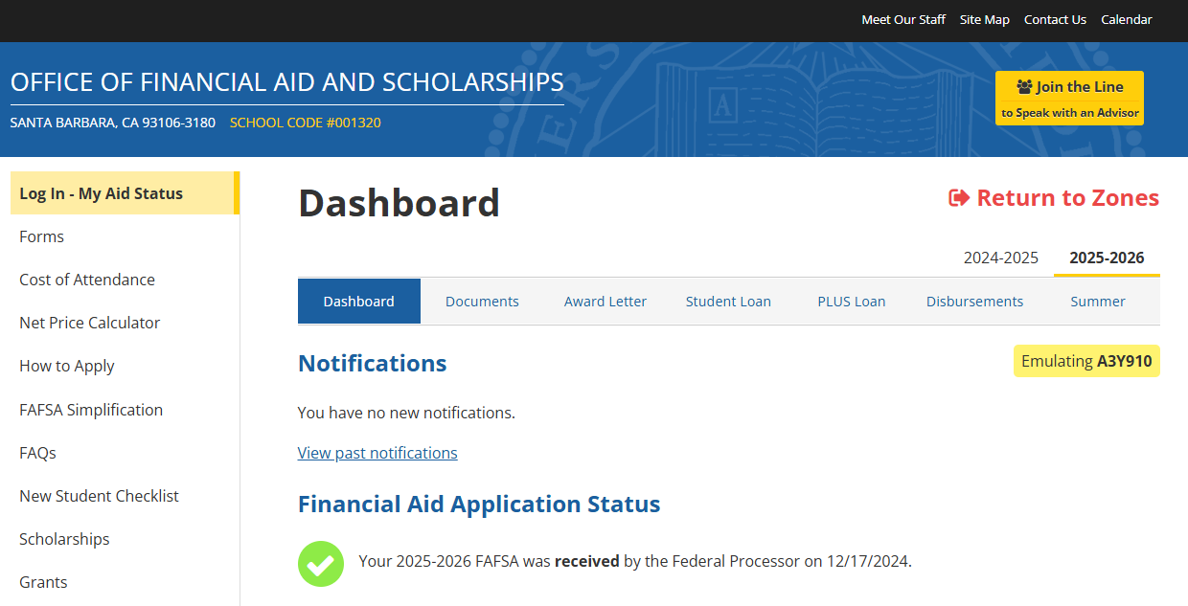
Notes:
After the student has logged in, they can access their work study referral or check to see if they have work study through the “Award Letter” tab.

Slide 14
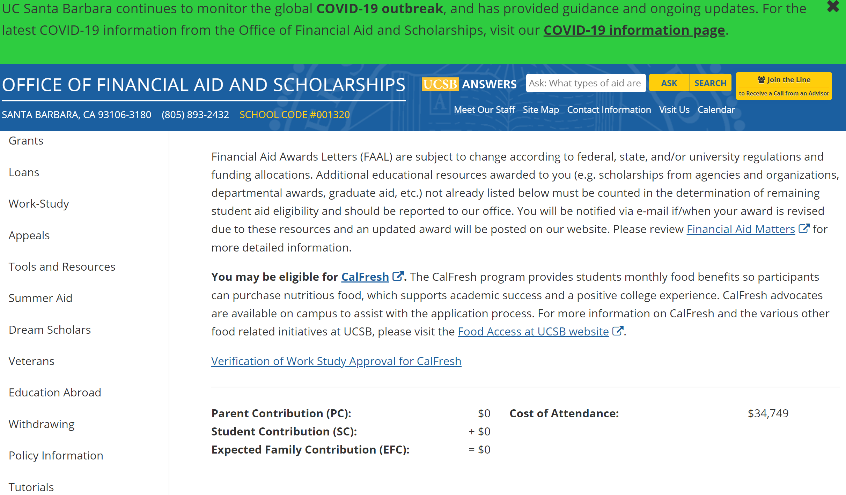
SCROLL DOWN
Notes:
After clicking on the “Award Letter” tab, students will need to scroll down to see their full award letter.

Slide 15
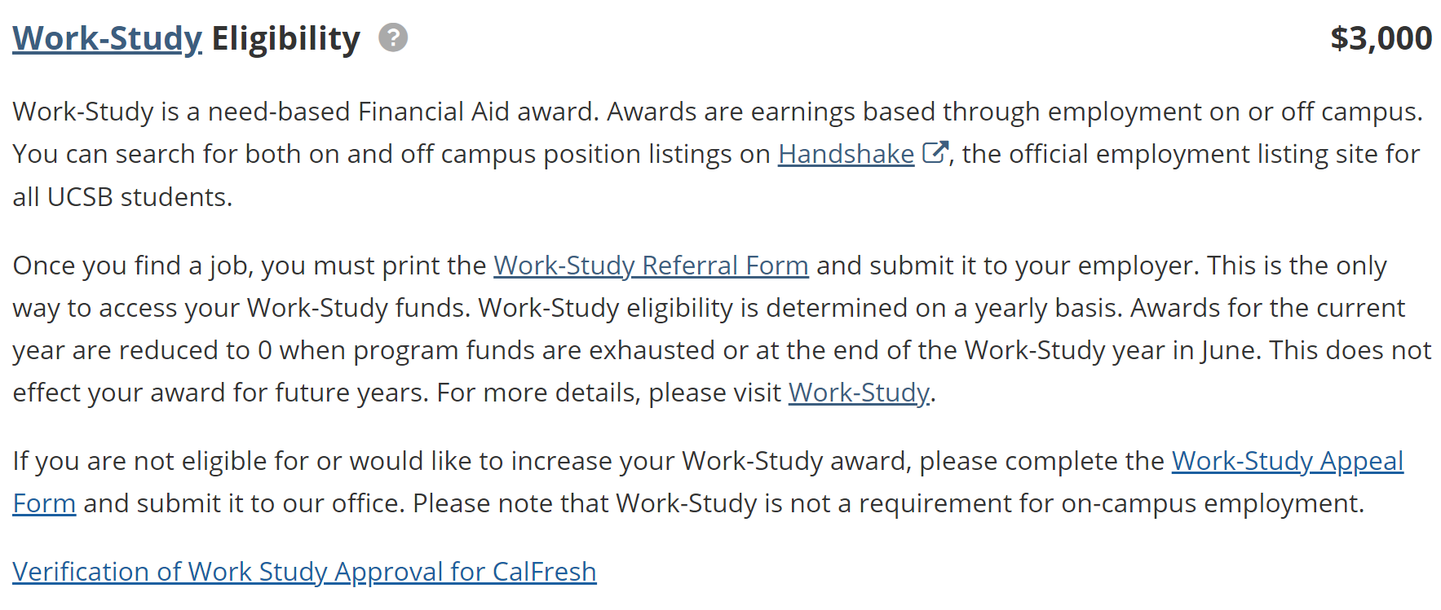
Click on question mark (?)
Notes:
Once student sees “Work-Study Eligibility” they will need to click on the question mark
Student will then see the link to “Work-Study Referral Form”

Slide 16
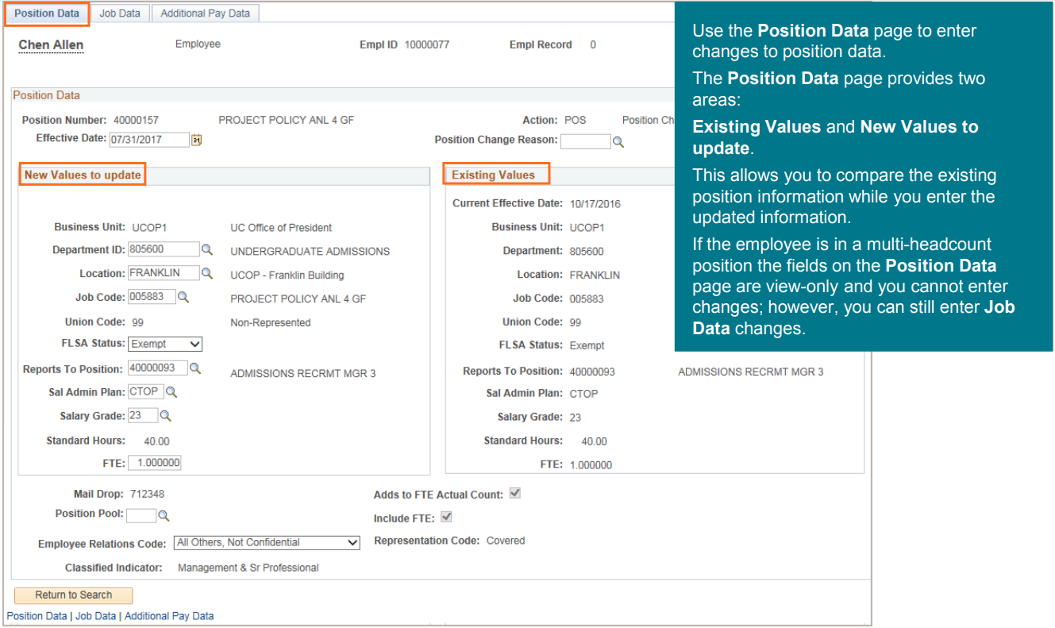
SINGLE EXISTING FILLED POSITION > ADD POOL ID
PeopleSoft Homepage > Workforce Administration > HR Tasks > PayPath/Additional Pay > PayPath Actions

Slide 17
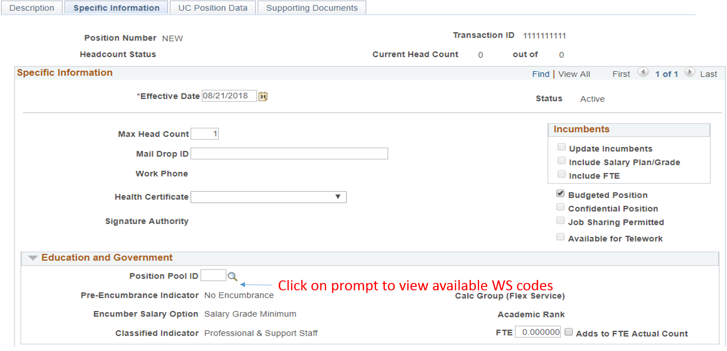
POSITION POOL IDs
Notes:
POSITION POOL ID
NOTES
The Position Pool IDs for your department should already be configured in UCPath. Once you’ve clicked the magnifying glass, you can see the list of Position Pool IDs your department can use

Slide 18
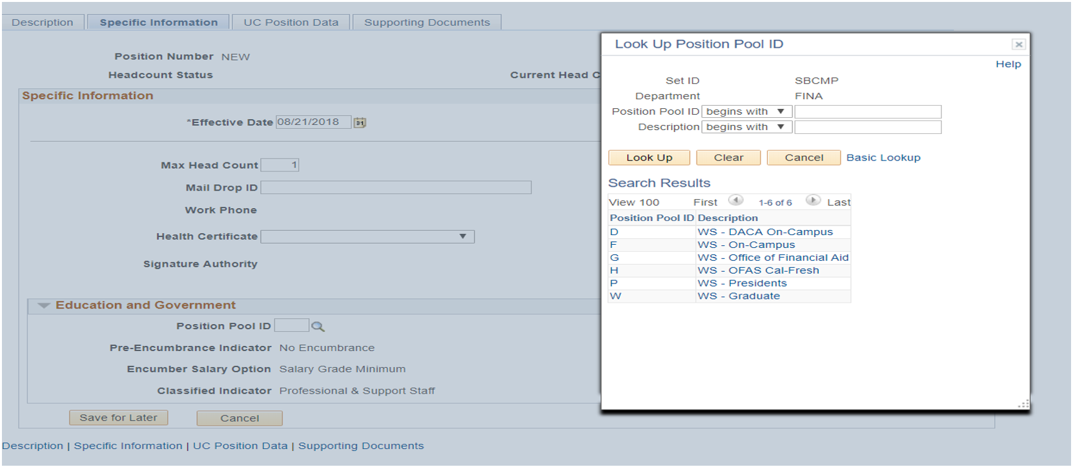
POSITION POOL IDs
Notes:
POSITION POOL ID
NOTES
Should you see a Position Pool ID missing from your list that should be there, please notify our department.

Slide 19
SINGLE POSITION > REMOVE POOL ID
PeopleSoft Homepage > Workforce Administration > HR Task > PayPath/Additional Pay > PayPath Actions

Slide 20
WORK STUDY CODES FOR SALARY COST TRANSFERS
D Full Split - Department Share
W Full Split - Work Study Share
S Partial Split - Department Share
P Partial Split - Work Study Share
Y Partial Split - Department Non-Work Study Share
X Split Refusal No Balance
Z FAU Error
Notes:
SALARY COST TRANSFER - WORK STUDY CODES
NOTES:
Not to be confused with the previous terminology, these work study codes are used for salary cost transfers. Salary Cost Transfers will replace the previous LX/RX of PPS - transferring earnings.
These work study codes are used to determine splits.

Slide 21

Work-Study Award = CalFresh Eligibility!!
CalFresh Advocates available to assist with applications!
foodbank.as.ucsb.edu & food.ucsb.edu
Advocates available via virtual chats,
Phone (805-893-2786), or Email thrive@ucsb.edu.
Verification of Work-Study Approval for CalFresh
available on student Financial Aid Award Letters
Check website: http://food.ucsb.edu/calfresh
Notes:
CalFresh is an entitlement program that provides monthly benefits to assist low-income households in purchasing the food they need to maintain adequate nutritional levels. Many of our work study students are typically food insecure and are eligible for CalFresh which can assist them in buying the groceries. For some students it can mean the difference between paying rent and buying groceries, so we encourage our on-campus departments to spread the word and encourage our work study students to apply to CalFresh and other resources that can help them succeed during their time in college. Students can apply with a CalFresh Advocate during these Summer Session B times or during Fall Quarter where these hours will be updated. You can get more information at foodbank.as.ucsb.edu or at food.ucsb.edu.

Slide 22
UC SANTA BARBARA
Office of Financial Aid & Scholarships
THANK YOU!
Please email Questions to: FINAIDWSP@sa.ucsb.edu
Maria Galicia | maria.galicia@sa.ucsb.edu | x5017
Christina Gutierrez | gutierrc@ucsb.edu | x7055
Notes:
That concludes the end of our training. We have some evaluations for you all to fill out. Although they are not required, we encourage honest and constructive feedback to improve our future work study trainings. Thank you.

